Slide 1
Human Activity Recognition
Edwin Candinegara

Slide 2
Objectives
Real-time Smartphone based Human Activity Recognition
Smartwatch based Human Activity Recognition
Notes:
= Data collection process → documentation
= Activity description
Versus available data currentls

Slide 3
Data Collection
6 persons – including myself (3 males, 3 females, 19-21 years old)
Collected Data Summary:
15 activities / person
Number of Minutes:
Edwin: 89 mins
Richsen: 90 mins
Lauren: 45 mins
Shelina: 45 mins
Mellita: 45 mins
Nikolas: 45 mins
TOTAL: 357.5 mins

Slide 4
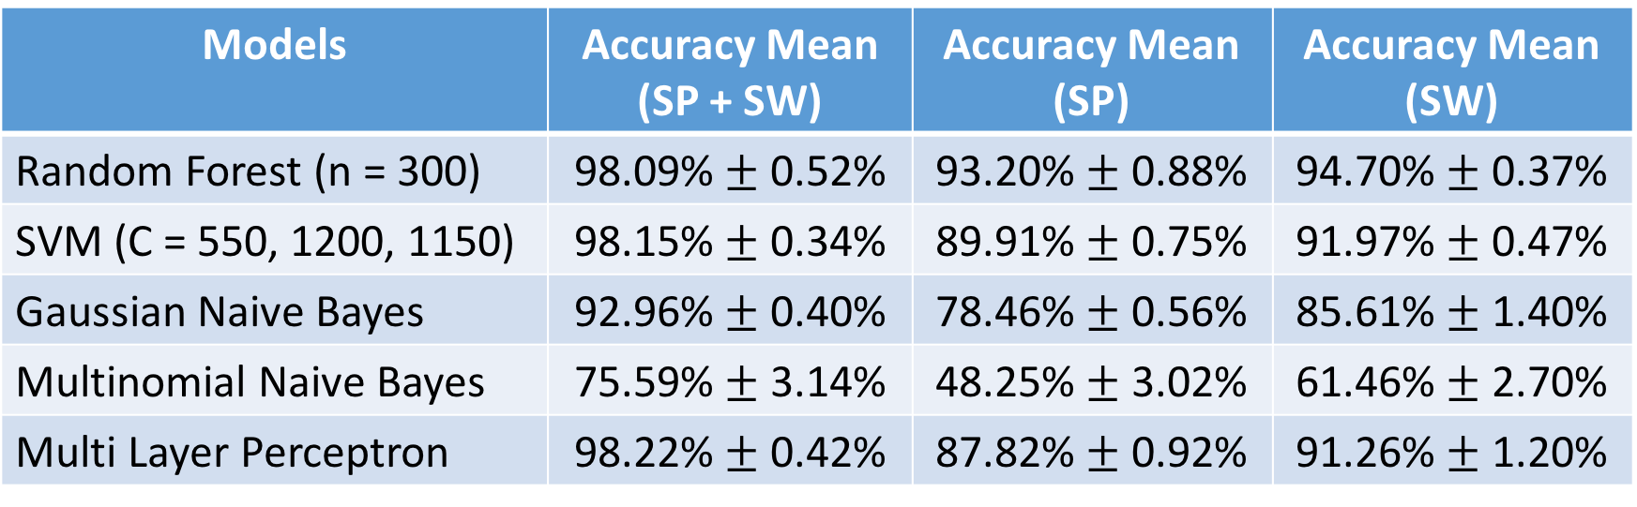
5-Fold on Single Dataset (Edwin’s Dataset)
15 activities, Sampling @ 10 Hz, Window size = 2s
Models | Accuracy Mean (SP + SW) | Accuracy Mean (SP) | Accuracy Mean (SW)
Random Forest (n = 300) | 98.09% $±$ 0.52% | 93.20% $±$ 0.88% | 94.70% $±$ 0.37%
SVM (C = 550, 1200, 1150) | 98.15% $±$ 0.34% | 89.91% $±$ 0.75% | 91.97% $±$ 0.47%
Gaussian Naive Bayes | 92.96% $±$ 0.40% | 78.46% $±$ 0.56% | 85.61% $±$ 1.40%
Multinomial Naive Bayes | 75.59% $±$ 3.14% | 48.25% $±$ 3.02% | 61.46% $±$ 2.70%
Multi Layer Perceptron | 98.22% $±$ 0.42% | 87.82% $±$ 0.92% | 91.26% $±$ 1.20%

Slide 5
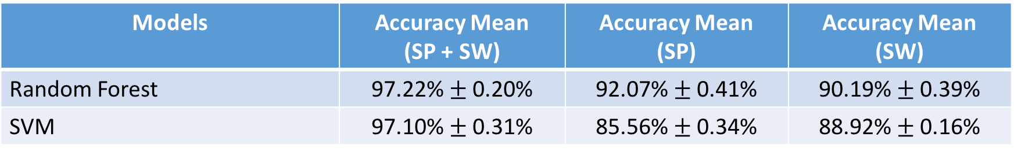
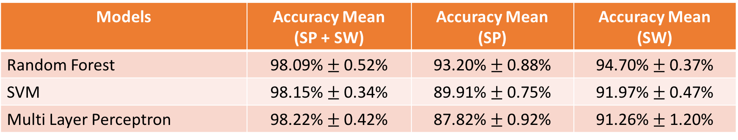
5-Fold CV on Combined Dataset (6 persons)
15 activities, Sampling @ 10 Hz, Window size = 2s
For comparison with the Single Dataset results:
Models | Accuracy Mean (SP + SW) | Accuracy Mean (SP) | Accuracy Mean (SW)
Random Forest | 97.22% $±$ 0.20% | 92.07% $±$ 0.41% | 90.19% $±$ 0.39%
SVM | 97.10% $±$ 0.31% | 85.56% $±$ 0.34% | 88.92% $±$ 0.16%
Models | Accuracy Mean (SP + SW) | Accuracy Mean (SP) | Accuracy Mean (SW)
Random Forest | 98.09% $±$ 0.52% | 93.20% $±$ 0.88% | 94.70% $±$ 0.37%
SVM | 98.15% $±$ 0.34% | 89.91% $±$ 0.75% | 91.97% $±$ 0.47%
Multi Layer Perceptron | 98.22% $±$ 0.42% | 87.82% $±$ 0.92% | 91.26% $±$ 1.20%
Notes:
SVM:
SW → C = 10000, Gamma = 0.5, Kernel = RBF
SP → C = 10000, Gamma = 1, Kernel = Poly, Degree = 7
SP + SW → C = 50, Gamma = 1, Kernel = RBF
RF:
SW → n = 1000
SP → n = 1000
SP + SW → n = 1000

Slide 6
Observations
Slightly lower compared to single dataset K-Fold
RF model trained using SW data is now lower than if using SP data
More variance due to multiple data subjects involved
In general, it is still good enough!

Slide 7
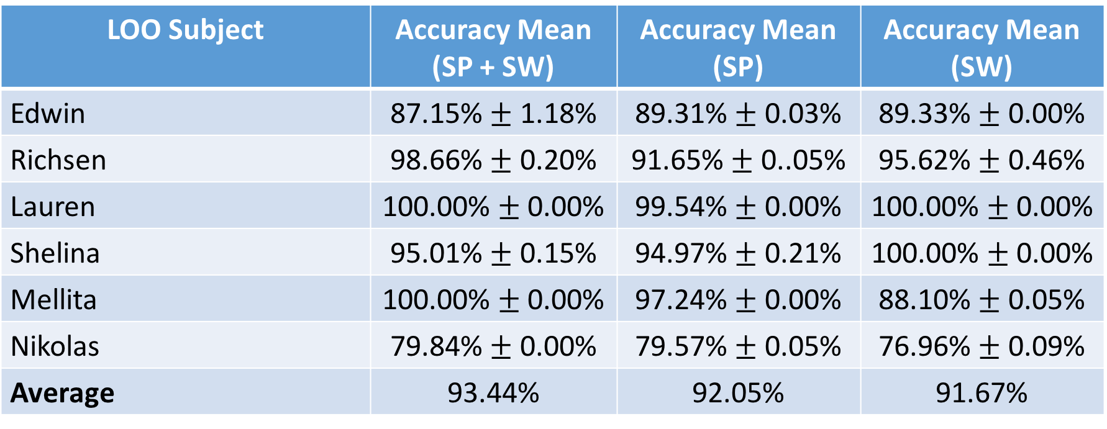
LOO with Selected Activities
5 basic activities: standing, sitting, lying down, walking, running
Random Forest → n = 1000, 3 times per subject
LOO Subject | Accuracy Mean (SP + SW) | Accuracy Mean (SP) | Accuracy Mean (SW)
Edwin | 87.15% $±$ 1.18% | 89.31% $±$ 0.03% | 89.33% $±$ 0.00%
Richsen | 98.66% $±$ 0.20% | 91.65% $±$ 0..05% | 95.62% $±$ 0.46%
Lauren | 100.00% $±$ 0.00% | 99.54% $±$ 0.00% | 100.00% $±$ 0.00%
Shelina | 95.01% $±$ 0.15% | 94.97% $±$ 0.21% | 100.00% $±$ 0.00%
Mellita | 100.00% $±$ 0.00% | 97.24% $±$ 0.00% | 88.10% $±$ 0.05%
Nikolas | 79.84% $±$ 0.00% | 79.57% $±$ 0.05% | 76.96% $±$ 0.09%
Average | 93.44% | 92.05% | 91.67%

Slide 8
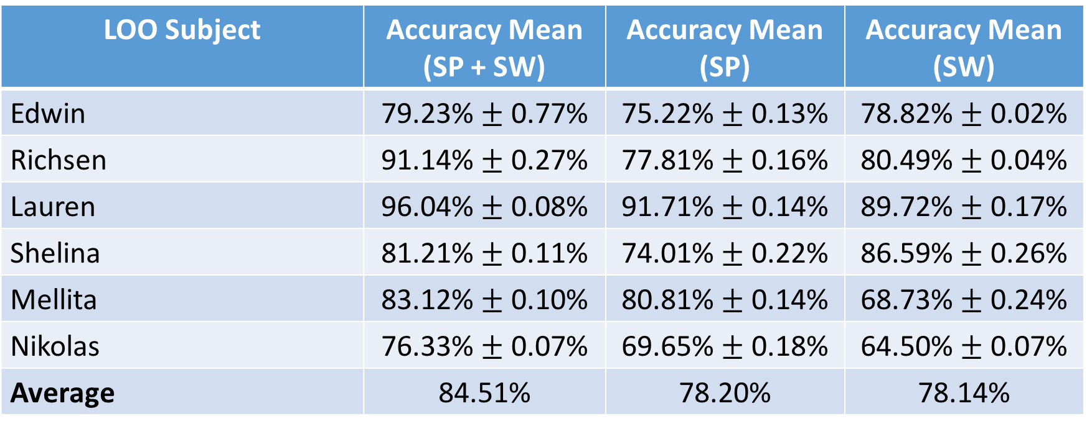
LOO with Selected Activities
5 Basic Activities + Going Upstairs + Going Downstairs
Random Forest → n = 2000, 3 times per subject
LOO Subject | Accuracy Mean (SP + SW) | Accuracy Mean (SP) | Accuracy Mean (SW)
Edwin | 79.23% $±$ 0.77% | 75.22% $±$ 0.13% | 78.82% $±$ 0.02%
Richsen | 91.14% $±$ 0.27% | 77.81% $±$ 0.16% | 80.49% $±$ 0.04%
Lauren | 96.04% $±$ 0.08% | 91.71% $±$ 0.14% | 89.72% $±$ 0.17%
Shelina | 81.21% $±$ 0.11% | 74.01% $±$ 0.22% | 86.59% $±$ 0.26%
Mellita | 83.12% $±$ 0.10% | 80.81% $±$ 0.14% | 68.73% $±$ 0.24%
Nikolas | 76.33% $±$ 0.07% | 69.65% $±$ 0.18% | 64.50% $±$ 0.07%
Average | 84.51% | 78.20% | 78.14%

Slide 9
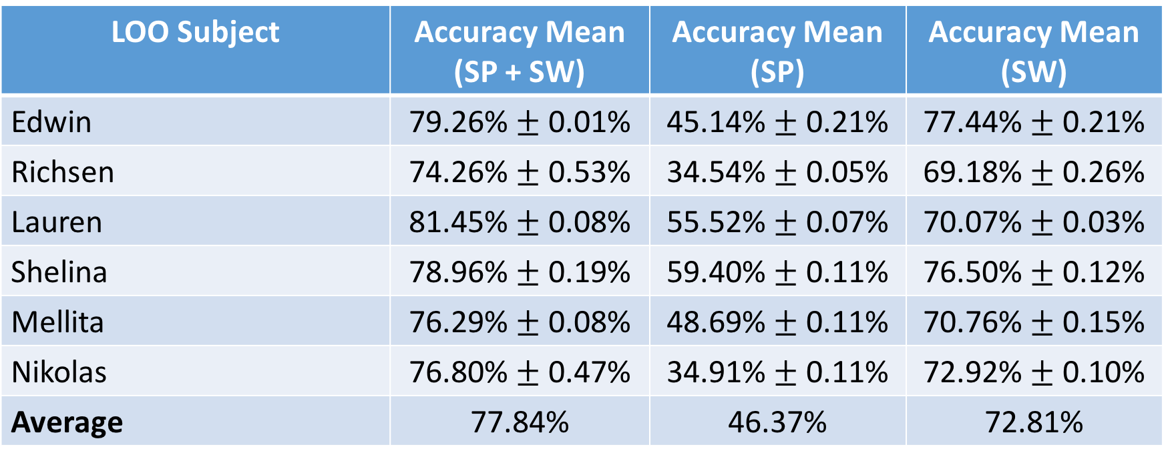
LOO for All Activities
15 Activities
Random Forest → 2000 estimators, 3 times per subject
LOO Subject | Accuracy Mean (SP + SW) | Accuracy Mean (SP) | Accuracy Mean (SW)
Edwin | 79.26% $±$ 0.01% | 45.14% $±$ 0.21% | 77.44% $±$ 0.21%
Richsen | 74.26% $±$ 0.53% | 34.54% $±$ 0.05% | 69.18% $±$ 0.26%
Lauren | 81.45% $±$ 0.08% | 55.52% $±$ 0.07% | 70.07% $±$ 0.03%
Shelina | 78.96% $±$ 0.19% | 59.40% $±$ 0.11% | 76.50% $±$ 0.12%
Mellita | 76.29% $±$ 0.08% | 48.69% $±$ 0.11% | 70.76% $±$ 0.15%
Nikolas | 76.80% $±$ 0.47% | 34.91% $±$ 0.11% | 72.92% $±$ 0.10%
Average | 77.84% | 46.37% | 72.81%

Slide 10
Observations
Going Upstairs, Going Downstairs → confused with Walking and Running
Removing Food Preparation and Folding boosts up the results
Confused with Standing
Eating, Writing, Reading, Typing → confused with Sitting and Lying
Most likely because they are sitting based activities

Slide 11
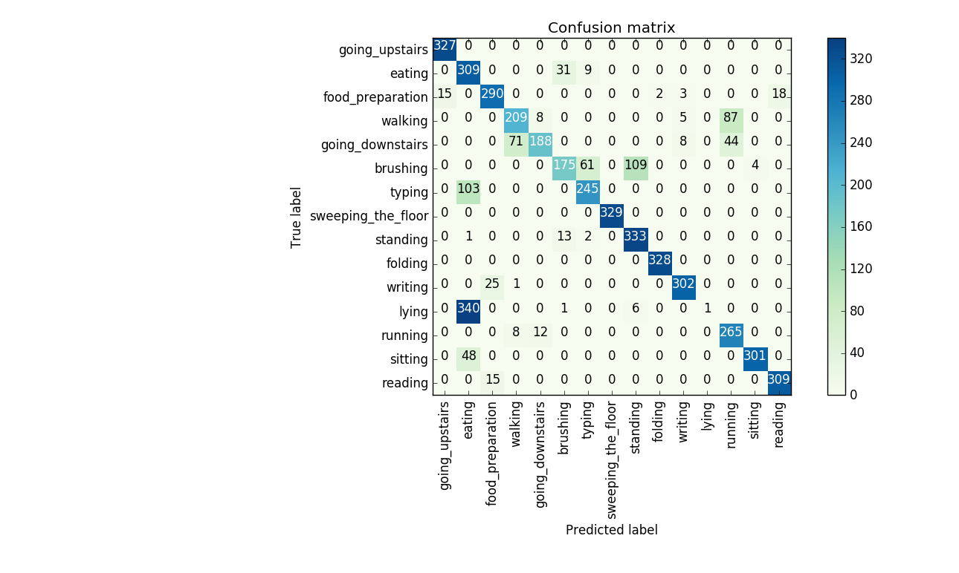
Confusion Matrix (SP + SW) - Edwin
Different test subject will have different “major wrong activity”
Expected as that subject’s behavior may not be captured by other subjects
Results have improved significantly by adding more subjects
The results may be improved further with even more subjects

Slide 12
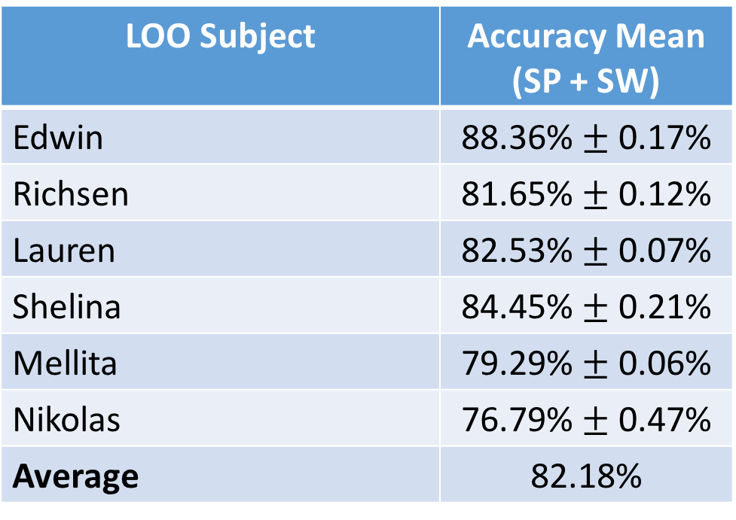
LOO for All Activities
14 Activities (without Eating)
Random Forest → 2000 estimators, 3 times per subject
LOO Subject | Accuracy Mean (SP + SW)
Edwin | 88.36% $±$ 0.17%
Richsen | 81.65% $±$ 0.12%
Lauren | 82.53% $±$ 0.07%
Shelina | 84.45% $±$ 0.21%
Mellita | 79.29% $±$ 0.06%
Nikolas | 76.79% $±$ 0.47%
Average | 82.18%

Slide 13
Real Time Monitoring
Due to the fact that there is a maximum connection limitation imposed by the tunnel provider, data is still 2 seconds, but it is sent to the server every 3 seconds.
Pipeline:
Data sent from SP and SW, stored in the DB
A worker thread will periodically process the next dataset
Sampling (10 Hz), Feature Generation →exactly the same as K-Fold pre-processing
Predicted using a Random Forest model trained on combined full data (6 persons)!
Use RF since it is easier to find the best parameter (only number of decision trees)
Sent to the web application

Slide 14
Real Time Monitoring Demo

Slide 15
Data Collection Plan
Let: n = number of persons
Total Activities Time = 45 minutes
Initial setup = 10 minutes
Sending data + preparing for next activity = ~2 minutes
TOTAL TIME NEEDED = 10 + [45 + 2 x 14] = 83 minutes / person
Potential Issues with Self Data Collection:
System setup (need to install frameworks, server setup, etc.)
Participant is not used to the data collection procedure and may miss a few preparation steps

Slide 16
What’s Next?
Gather more friends’ data
Target is 10 friends before 22 December 2016
More subjects = more behaviors covered = better LOO results!
Try out Dr. Wang’s method of adding the same data but with different axes permutations
Add (X, Y, Z), (Y, X, Z), etc.
Generate features (other than correlations) for all permutations

